Slide 1
Banking Credit System
zzzz
zzzzzzz

Slide 2
Contents
1
Introduction
2
Development process
3
Demo
4
Q&A

Slide 3
Project management
Quality Assurance
Result
Introduction
Long làm
10m
Group
Presentation style
Business context
Plan
Development process
Requirement
Design
Implement
Testing
Demo
Q&A

Slide 4
Project management
Quality Assurance
Result
Introduction
Role, responsibility, time table
Giang
5m
Group
Project
Business context
Plan
Development process
Requirement
Design
Implement
Testing
Demo
Q&A

Slide 5
Project management
Quality Assurance
Result
Introduction
Ly, 10m
- Chỉ ra mỗi ng làm 1 phần (có thể dùng matrix table),
review, chỉ ra hoạt động review,
Template
3 phiên bản requirement (t Việt, t Anh, bản Doc cho report 3)
tìm hiểu nghiệp vụ
Group
Project
Business context
Plan
Development process
Requirement
Design
Implement
Testing
Demo
Q&A

Slide 6
Project management
Quality Assurance
Result
Introduction
Chính
Cho nhiều hình ảnh
Bao gồm cả DB và DDD
Model trực quan
DB: thỏa mãn chức năng của chương trình và phải kế thừa được dữ liệu, đảm bảo chuẩn 3
Architecture design: 3 tiers, middle tier: MVC
Cần đảm bảo chính xác, có khả năng cao sẽ bị thầy Trí bắt bẻ
Component diagram, modules
DDD: show ảnh
Group
Project
Business context
Plan
Development process
Requirement
Design
Implement
Testing
Demo
Q&A

Slide 7
Project management
Quality Assurance
Result
Introduction
Giang + Chính + Ly
Giang
Cách làm việc
Ly:
Ranking
Chính:
Mining, algorithms
Group
Project
Business context
Plan
Development process
Requirement
Design
Implement
Testing
Demo
Q&A

Slide 8
Project management
Quality Assurance
Result
Introduction
Thảokun + Giang, 12-15m
Cách làm việc (log bug lên google code, assign, prioroty…)
TC: viết ngay sau requirement
Thống kê
Template
Group
Project
Business context
Plan
Development process
Requirement
Design
Implement
Testing
Demo
Q&A

Slide 9
Project management
Quality Assurance
Result
Introduction
Test strategy follows V-model
Group
Project
Coding
Testing
Business context
Coding
Acceptance
System
Integration
Unit
Requirements
High-level design
Detailed design
Plan
Development process
Requirement
Design
Implement
Testing
Demo
Q&A

Slide 10
Project management
Quality Assurance
Result
Introduction
Testing process
Group
Project
Create TC template
Write TC (based on SRS)
Review TC
Create test data
IT
Business context
Plan
Development process
Requirement
Design
Implement
Testing
Demo
Q&A

Slide 11
Project management
Quality Assurance
Result
Introduction
Testing process
Group
Project
Test case
Test data
Integration test
Business context
Plan
Development process
Requirement
Design
Implement
Testing
Demo
Q&A

Slide 12
Project management
Quality Assurance
Result
Introduction
Testing activities
Code
Unit test
Review code
Integration test
Log bug
Group
Project
Business context
Plan
Development process
Requirement
Design
Implement
Testing
Demo
Q&A

Slide 13
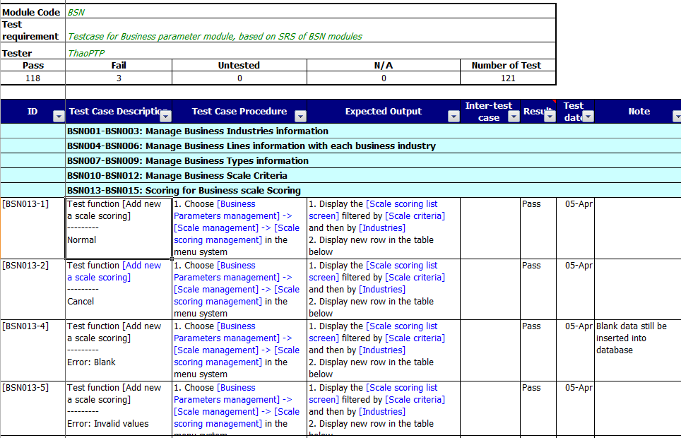
Project management
Quality Assurance
Result
Introduction
Test case
Group
Project
Business context
Plan
Development process
Requirement
Design
Implement
Testing
Demo
Q&A

Slide 14
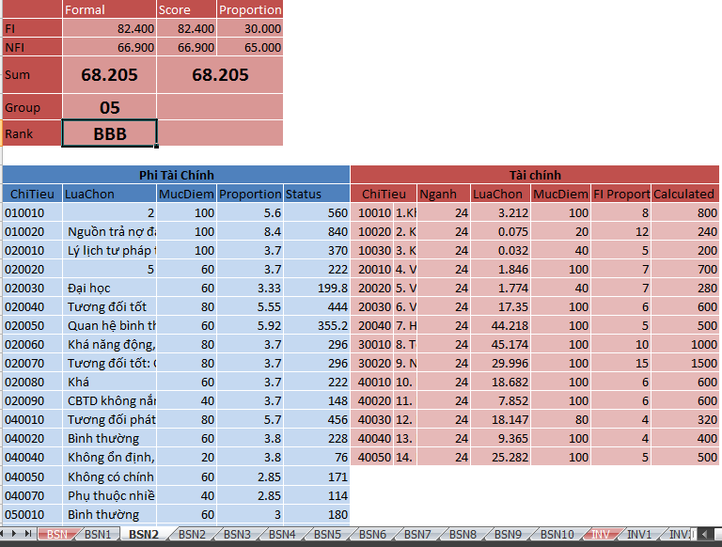
Project management
Quality Assurance
Result
Introduction
Test data
Group
Project
Business context
Plan
Development process
Requirement
Design
Implement
Testing
Demo
Q&A

Slide 15
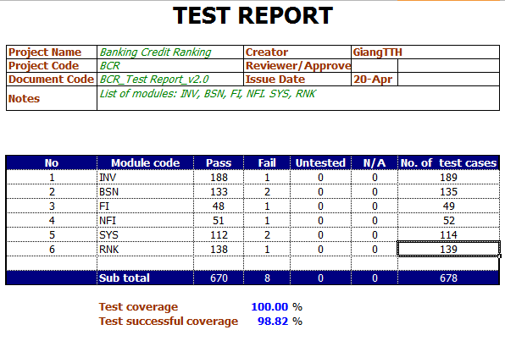
Project management
Quality Assurance
Result
Introduction
Test report
Group
Project
Business context
Plan
Development process
Requirement
Design
Implement
Testing
Demo
Q&A

Slide 16
Project management
Quality Assurance
Result
Introduction
Ro
Group
Project
Business context
Plan
Development process
Requirement
Design
Implement
Testing
Demo
Q&A

Slide 17
Hot Tip
How do I incorporate my logo to a slide that will apply to all the other slides?
On the [View] menu, point to [Master], and then click [Slide Master] or [Notes Master]. Change images to the one you like, then it will apply to all the other slides.

Slide 18
Diagram
Title
Add your text
ThemeGallery is a Design Digital Content & Contents mall developed by Guild Design Inc.
ThemeGallery is a Design Digital Content & Contents mall developed by Guild Design Inc.

Slide 19
Cycle Diagram
Add Your Text
Text
Text
Text
Cycle name
Text
Text

Slide 20
Diagram
Text
Add Your
Title Text
Text 1
Text 2
Text 3
Text 4
Text 5
Add Your
Title Text
Text 1
Text 2
Text 3
Text 4
Text 5
Text
Text
Text
Text

Slide 21
Diagram
Text
Text
Concept
Text
Text
Text
Text
Add Your Text

Slide 22
Diagram
Add Your Text
Add Your Text
Add Your Text
Add Your Text
Add Your Text
Add Your Text
Add Your Text
Add Your Text

Slide 23
Diagram
Add Your Text
Add Your Text
Add Your
Title
Add Your Text

Slide 24
Diagram
Text
Text
Text
ThemeGallery is a Design Digital Content & Contents mall developed by Guild Design Inc.
ThemeGallery is a Design Digital Content & Contents mall developed by Guild Design Inc.
ThemeGallery is a Design Digital Content & Contents mall developed by Guild Design Inc.

Slide 25
Diagram
Text
Text
Text
Add Your Title
Text

Slide 26
Cycle Diagram
Add Your Text
B
Add Your Text
A
C
Add Your Text
Concept
E
D
Add Your Text
Add Your Text

Slide 27
Diagram
1
2
3
ThemeGallery is a Design Digital Content & Contents mall developed by Guild Design Inc.
ThemeGallery is a Design Digital Content & Contents mall developed by Guild Design Inc.
ThemeGallery is a Design Digital Content & Contents mall developed by Guild Design Inc.

Slide 28
Diagram
2001
2002
2003
2004
Your Text
Your Text
Your Text
Your Text
Your Text
Your Text
Your Text
Your Text

Slide 29
Diagram
Add Your Text
Add Your Text
Add Your Text
Add Your Text

Slide 30
Block Diagram
TEXT
TEXT
TEXT
TEXT
TEXT
TEXT
TEXT
TEXT

Slide 31
Table
 | Title | Title | Title | Title | Title
Title | O | O | O | O | O
Title | O | O | O | O | O
Title | O | O | O | O | O
Title | O | O | O | O | O
Title | O | O | O | O | O
Title | O | X | O | X | O

Slide 32
3-D Pie Chart
Text2
Text3
Text1
Text4
Text5

Slide 33
Block Diagram
Add Your Text
Add Your Text
concept
Concept
Concept
Concept

Slide 34
Thank You !
www.themegallery.com

